Slide 1
Motor controller
Jake Neal
Cameron Shea
Notes:
Cameron

Slide 2
Play By PLay
Keypad
Pulse Width Modulation & Stopwatch
Circuitry
Control System
Conclusions
Notes:
Cameron
Mention the “division” between “circuitry” and “control system”

Slide 3
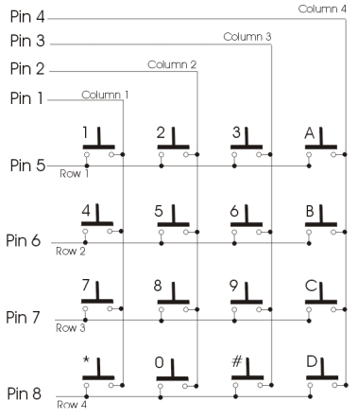
Keypad
Velleman 16-Key Matrix
Operation
8 Output Lines
16 Possibilities
How do we know which key was pressed?
http://www.eng.auburn.edu/~nelson/courses/elec3040_3050
Notes:
Explain the operation
-pushing button closes the circuit
-pull up resistors provide voltage difference to “see” on the output

Slide 4
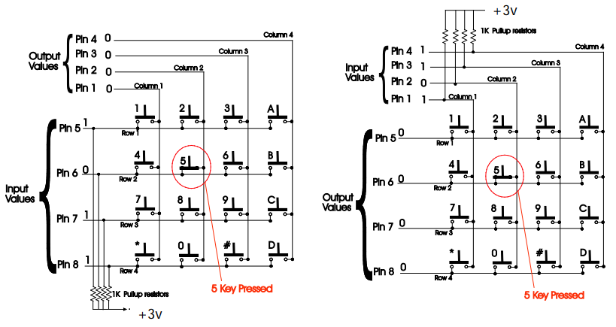


Keypad (cont.)
Standard Scan Algorithm
Scans all 8 pins when pressed
Risky Business (Cue Tom Cruise…)
Alternate
Read the column and then row
This way is the…
http://www.eng.auburn.edu/~nelson/courses/elec3040_3050
Tom Cruise Image: www.gstatic.com
Safeway Logo: vignette.wikia.nocookie.net/logopedia
Notes:
Algorithm
-column by column until found
-row by row until found
Alternate
-read all rows
-read all columns
-LOGIC!
-If else if
-x row && y column → __ key
Sidenote
-long drawn out code is a common theme with us…BUT IT WORKED!

Slide 5
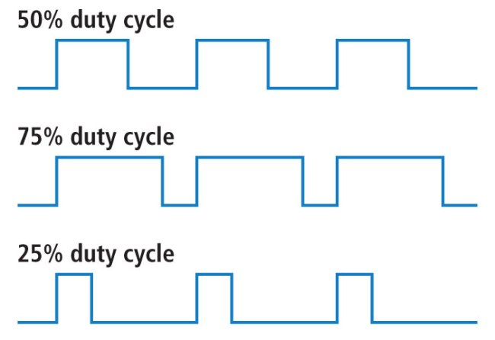
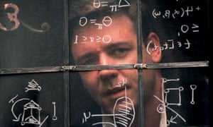
Pulse Width Modulation & stopwatch
Both controlled by timers
Basics of PWM
Duty Cycle
Period
Stopwatch
Timer 11 already sampled every 10 ms… and we needed 100ms…
cdn.sparkfun.com
Beautiful Mind: i.guim.co.uk
Notes:
Timers
-10 for the PWM
-11 for the stopwatch and control system (spoiler alert)

Slide 6
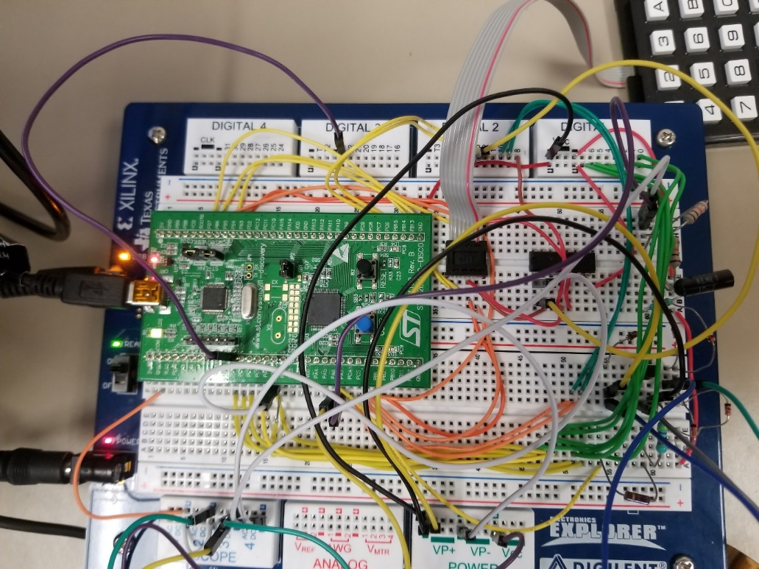
Circuitry
Boards
Noteworthy Circuitry
LEDs
Keypad
AND gate chip
“Fires”
Tau and voltage divider
Notes:
Fires: Amplifier and Rectifier
Voltage divider: 12V→?V

Slide 7

Control system
GOALS
Assign % of max speed from keypad
Work with or without load
Quickly vary speed
Improve Open-Loop time
www-tc.pbs.org
Notes:
Percents 0-100% in 10% increments, corresponding to keypad key
Faster than simply adding and subtracting to pwm until proper value is reached
Faster than standard steady state time

Slide 8
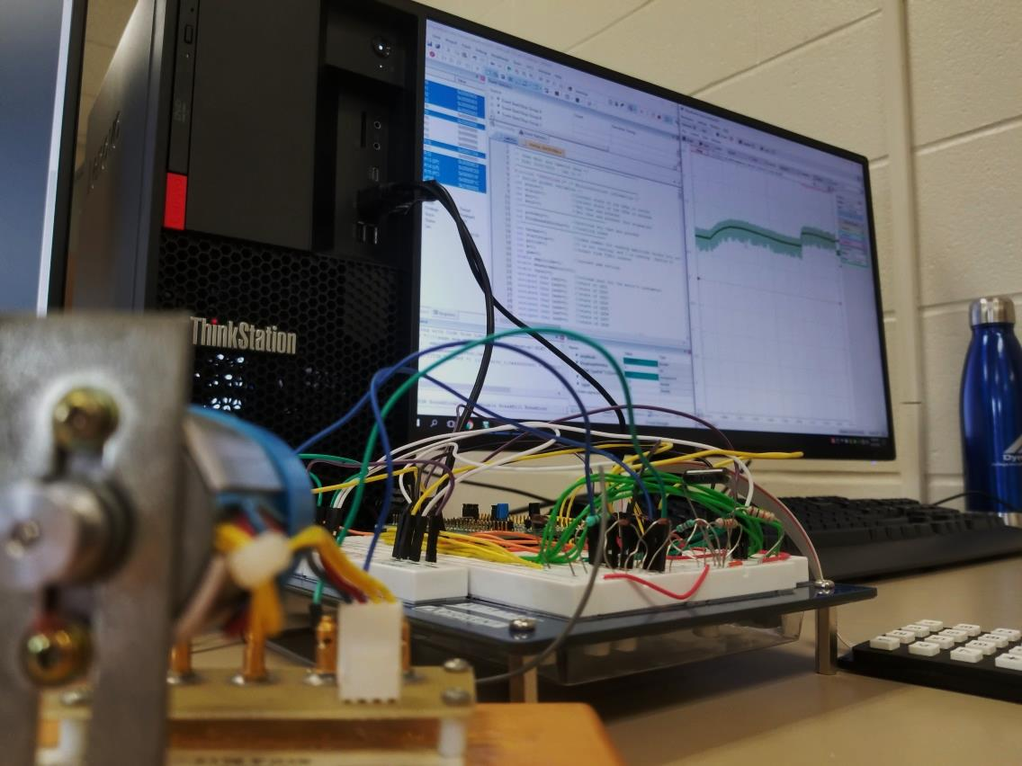
Control System (cont.)
Target PWM amount
Correction from target
Load effects on target speed
Notes:
Target Amount is the amount that we shoot for to gain speed quickly, NOT the final amount for voltage
Add or subtract from target above to get the target voltage
Load slows down our motor, causing a higher PWM to be necessary to get to the point

Slide 9
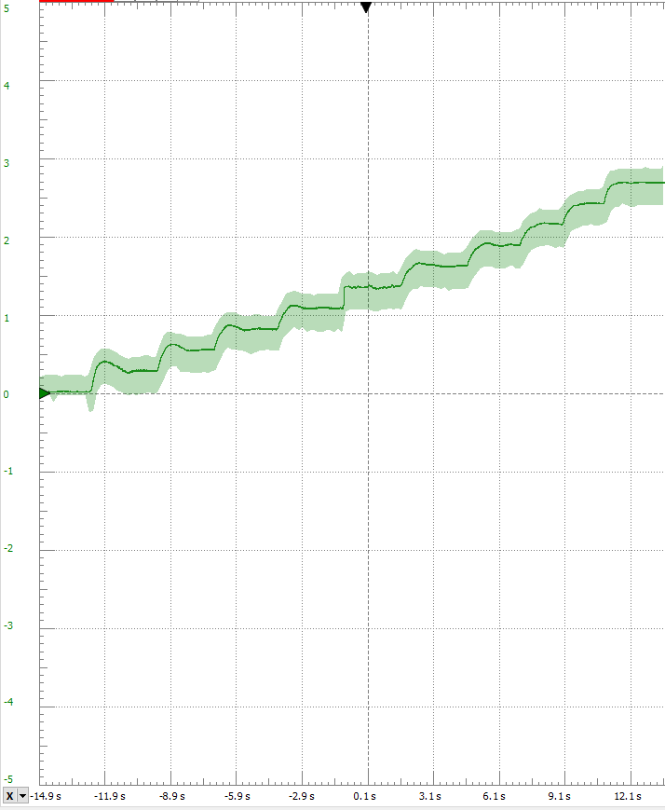
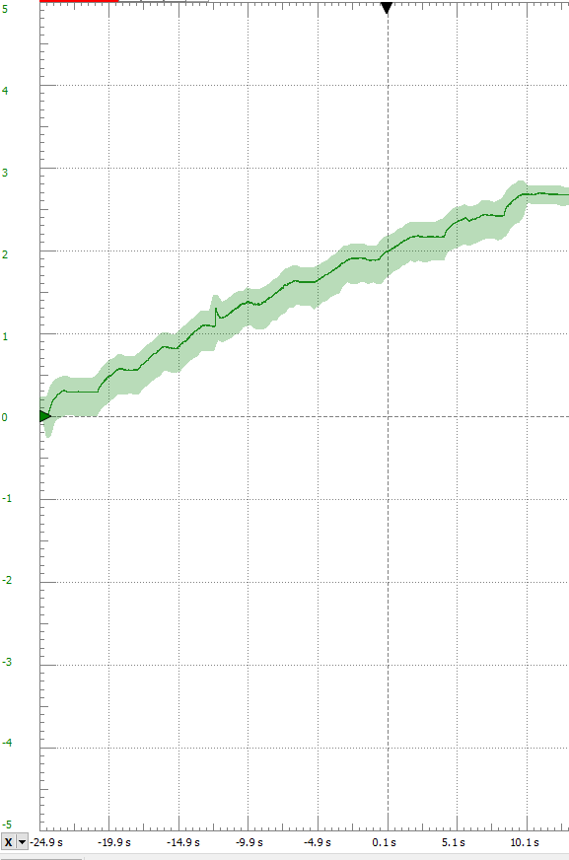
Control System (cont.)
System response without load
System response with load
Notes:
LEFT SIDE: All 10 keys, pressed sequentially, showing the motor voltage
RIGHT SIDE: Same, but under load. Note that the ‘5’ key has different logic in this photo due to testing the faster than open loop time

Slide 10
Control system (cont.)
Reducing Open Loop response time
Must be <50% Settling Time
<10% Overshoot
Between Key 4 and Key 5
Method
Overdrive for brief time
Set exact PWM, let system handle error
Notes:
Overdrive by setting PWM to Max: 16000. Done for 30ms
After 30ms is over, the PWM is set to an expected value of 9000, and the controller handles minute corrections from there

Slide 11
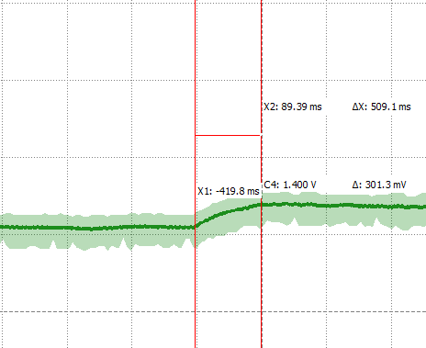
Control system (cont.)
Open Loop Results
Settling Time: Approx. 500ms
Settling Voltage: Approx. 1.35V
Notes:
It may say 1.4 but it was bouncing back and forth a tad, really 1.35V.

Slide 12
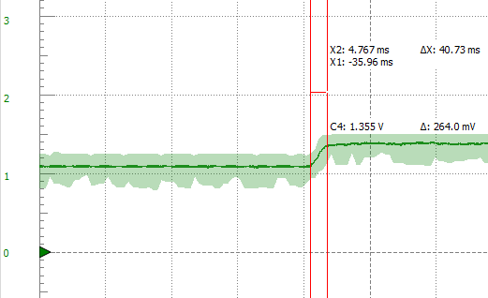
Control System (cont.)
Closed Loop Results
Settling Time: Approx. 40ms
8% of original time
Settling Voltage: Approx. 1.35V
% Overshoot: Approx. 0%
Notes:
Probably limited some by our RC Time Constant for measurement, but it slows and smooths our curve here most likely

Slide 13
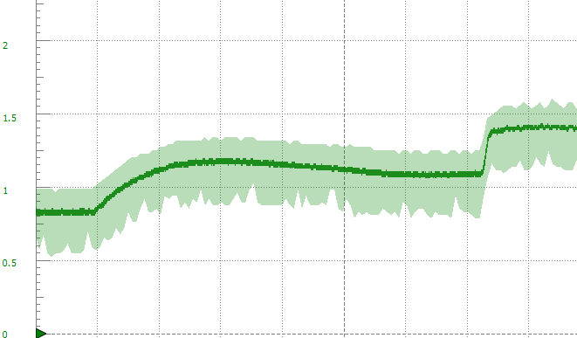
Control System (cont.)
Comparison of Open Loop (from 30-40%) and Controlled (from 40-50%)
Notes:
Small time scale here and not the same keys for Open Loop as above, but gets the point across

Slide 14
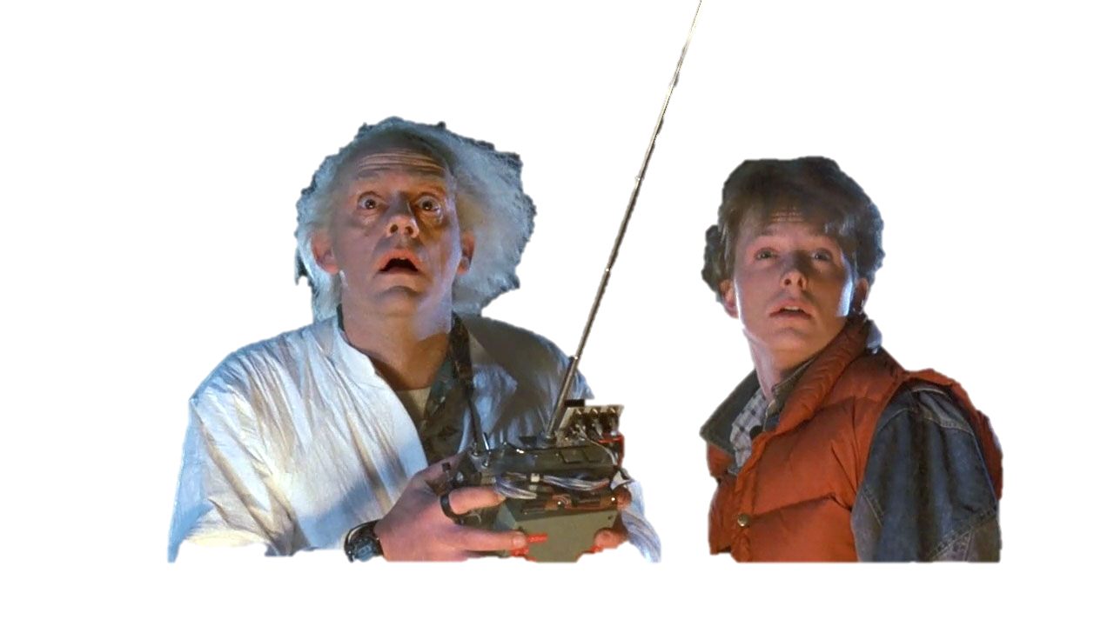
Summary
It works!
Functioning 16 Key Keypad
Speed Selection
Stopwatch start/stop and reset
Operational and accurate stopwatch
Accurate control system
With or without Load
Reduced Settling Time, no Overshoot
http://moviemezzanine.com
Notes:
Jake:
IT WORKS!!!
Which keys do what again
With or without load it doesn’t matter
40ms, or 8% settling time, 0% overshoot

Slide 15

Questions?
http://abnormaluse.com/
Notes:
You want the truth?
YOU CAN’T HANDLE THE TRUTH!

